Slide 1
ORGNON AND PAEDIATRICS
PRESENTED BY :
DR.SONNY MON .R
ASSISTANT PROFESSOR
DEPT.OF. ORGANON

Slide 2
MIASMATIC CHILD

Slide 3
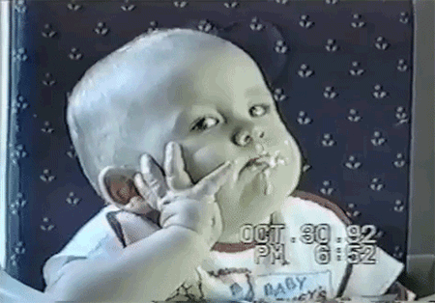
SYCOTIC CHILD
A child in the Sycotic phase is confused mentally and physically. He, thus, reacts in 4 different ways :
Reacts after a long time with a pause between action and reaction.
Reacts in a way which is harmful to himself [e.g., internalizing of the emotions or of the disease].
No reaction at all.
Repression of emotions.
k

Slide 4
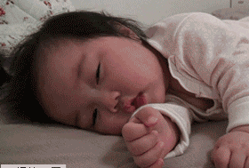
WORLD - confused because of fatigue.
slowness and dullness
always desires more for less effort.
self centred and selfish in nature.
MEMORY – poor
IDEAS - Sycotic children have a lot of non-constructive, negative or fixed ideas.
MILESTONE – delayed
- GAMES - usually do not enjoy playing because of their laziness and sluggishness. love watching sports

Slide 5
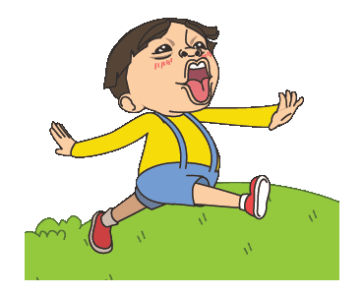
Psoric child:
Healthy, positive and constructive.
These children are born to healthy parents, and their growth.
Reaction to success and failure is quite positive. Thus, they do not accept defeat easily and always make an attempt to succeed.

Slide 6
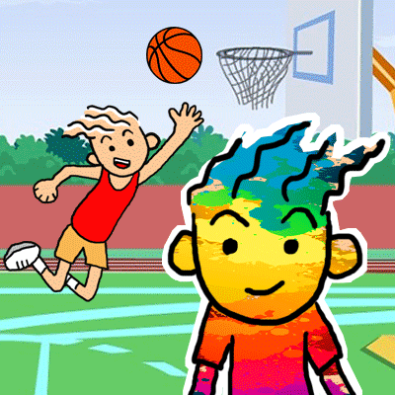
World:
quick to grasp what is being taught to them or even pick up facts from the world around them easily.
Memory:
They have an excellent memory.
Ideas:
Their concentration levels and moral values are very high.
Mile stone: Normal
GAMES: They will enjoy playing both outdoor and indoor games

Slide 7
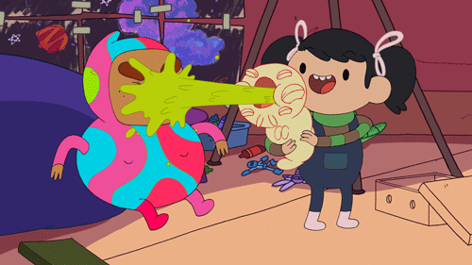
Syphilitic child:
The children with ashy grey faces and an appearance of marasmus.
Syphilitic stigma destroys not only the tissues but also the power to assimilate the proper materials from food.
Criminals and criminally insane
Night aggravation.
Always depressed and keep their troubles to themselves and sulk over them.
Melancholic and condemn themselves

Slide 8
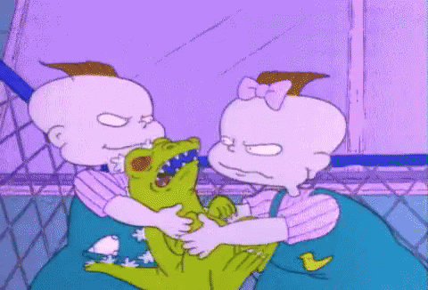
World:
Mentally dull, heavy, stupid and especially stubborn, sullen, morose and usually suspicious.
Unsocial
anxiety, restlessness
Memory:
They have an poor memory. Slow to comprehend and forget what they are about to say
Ideas:
Have fixed ideas
Mile stone: slow and delayed
GAMES: like adventurous games

Slide 9
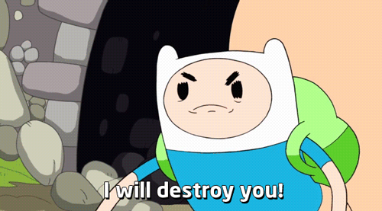
Mouth has pathological and structural changes, in the dental arch and teeth come through deformed irregular in shape and irregular in order of eruption.
Decaying of teeth.
Flabby muscles.
The adenoid tissue is always involved and the enlarged tonsils.
Ulcers of mouth with putrid sweet taste in the mouth.
Ravenous hunger, immediately after eating a full meal.
Craving for indigestible things like acids, sweets, chalk, lime and pencils etc…

Slide 10
SECOND PRESCRIPTON

Slide 11
SECOND PRESCRIPTION
The return of symptoms after the first prescription has exhausted its curative power.
The return symptom-image unfolds the knowledge by which we know whether the first prescription was the specific or the palliative, i. e., we may know whether the remedy was deep enough to cure all the deranged vital force or simply a superficially acting remedy, capable of only a temporary effect.
The many things learned by the action of the first remedy determine the kind of demand made upon the physician for the second prescription.
When the first prescription has been made

Slide 12
We have often acted too soon, but never waited too long." Many physicians fail because of not waiting, and yet the waiting must be governed by knowledge.
When the first prescription has been made and the remedy has been similar enough to change the existing image, we have but to wait for results.
The manner of change taking place in the totality of symptoms signifies everything, yet the manner of the return of the image, provided it has disappeared, signifies more.

Slide 13
If the first prescription was the similimum, the symptoms will return-and when they return-asking for the same remedy.
Too often the remedy has been only similar enough to the superficial symptoms to change the totality and the image comes back altered, therefore resembling another remedy, which must always be regarded as a misfortune, by which the case is sometimes spoiled, and the hand of the master may fail to correct the wrong done.

Slide 14
Proper time to change
Avoid haste
Wait and observe
Improper action
Remedies suitable to follow
Careful records
The similimum

Slide 15
When to repeat medicine?

Slide 16
APHORISM 247 5TH EDITION
Under these conditions, the smallest doses of the best selected homoeopathic medicines may be repeated with the best, often incredible results, at the interval of fourteen, twelve, ten, eight, seven days, and where rapidity is requisite, in chronic diseases resembling cases of acute diseases, at still shorter intervals, but in acute diseases, at very much shorter periods – every twenty four, twelve, eight, four hours, in the very acutest every hour, up to as often as every five minutes in every case in proportion to the more or less rapid course of the disease and of the action of the medicine employed, as is more distinctly explained in the last note.

Slide 17
§ 248 Fifth Edition:
The dose of the same medicine may be repeated several times according to circumstances, but only so long as until either recovery ensues, or the same remedy ceases to do good and the rest of the disease, presenting a different group of symptoms, demands a different homoeopathic remedy.

Slide 18
Age:
CHILDREN AND ADOLESCENT (1-20 Years) -High
ADULT (21-40 Years) - Medium
ABOVE 40 years –Low
Sex:
MALE - HIGH SUSCEPTIBILITY
FEMALE – LOW SUSCEPTIBILITY
Severity of disease:
MILD STAGE – HIGH
MODERATE – MODERATE
SEVERE – LOW

Slide 19
PREVIOUS TREATMENT:
ALLOPATHIC MEDICINE – HIGH
HOME REMEDY – MODERATE
NO TREATMENT – LOW
Nature of simillimum
PECULIAR,CHARACTERSTIC SYMPTOMS – HIGH
PARTIALLY SIMILAR REMEDY – MODERATE
COMMON SYMPTOMS - LOW

Slide 20
SANGUINE CHILD
Prefers to jump,skip and run on toes rather than to walk
Very active and always manage to have fun
They are social butterflies
Word will be occupied only by licking finger,nibbling the pencil,chewing shirt collars and other isometrics to devlop the mobility of expressions.
Constant flittering of eyelashes

Slide 21
Choleric child:
Captures everyones attention
Wants to be magnatised
theybare dominating
dynamic persons with big dreams and aims to reach them
they are unemotional.
Simply mesemerise by their activity and energy
In heat of enthusiasm the choleric child is often careless

Slide 22
Phlegmatic child:
They are very calm and peaceful
They are slow and stubborn
Easily mingle with others and donot have more enemies
They will be gentle clingy and fearful nature
Feels comfort in isolation
Over sensitive and cries easily

Slide 23
Melancholic:
Pale face
They are creative and deep thinkers
Dreaminess expressed with sigh
They will not Enjoy the energetic games
Isolation
They are deep thinkers

Slide 24
Posology:
Five consideration influence us n the choice o the dose:
The susceptibility of patient
The seat of the disease
The nature and intensity of the disease
The stages and duration of the disease
The previous treatment of the disease.

Slide 25
The more similar the remedy ,the more clearly and positively the symptoms of the patients take on the peculiar and characteristic form of the remedy ,the greater the susceptibility to that remedy and HIGHER the potency required.
Where the symptoms are not clearly developed and there is the absence or scarcity of characteristic features or where two or three remedies seem about equally indicated ,susceptibility and reaction may regraded as LOW.( 3 to 12 potency)

Slide 26
BY AGE:
- Susceptibility is greatest in children and young , vigorous persons and diminishes with ages.
- Children are sensitive during the development
- So medium and higher potencies.
BY TEMPERAMENT:
- Higher potency are best adapted to sensitive persons of the nervous, sangunine temperament, quick to act and react, to zealous and impulsive persons.
- Lower potency are better to torpid and phlegmatic individuals, dull of comprehension and slow to act , to coarse.

Slide 27
The single dose of the indicated remedy, repeated whenever improvement ceases, as long as new or changed symptoms do not indicate a change of remedy ,is adapted to all cases , but especially to chronic cases and to such acute cases as can be seen frequently and watched closely.

Slide 28
Mental stress during pregnancy:
D.H. Stott in a series of paper has showed that psychological stress during pregnancy may predispose the child to react in an undesirable way to subsequent adverse environment and so predispose to behavioural problems and in particular to juvenile delinquency.

Slide 29
THANK YOU

